Slide 1
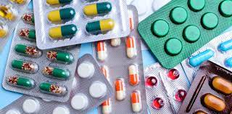
Chapter 3: Pharaceutical Drugs

Slide 2
Drugs
A drug is a chemical substance, typically of known structure, which, when administered to a living organism, produces a biological effect. A pharmaceutical drug, also called a medication or medicine, is a chemical substance used to treat, cure, prevent, or diagnose a disease or to promote well-being.

Slide 3
Steps in Drug Discovery
Step I: Target identification
Step II: Drug metabolism
Step III: Lead discovery
Step IV: Lead optimization
Step V: Pre-clinical and Clinical development

Slide 4
Classification of Drugs
I: On the basis of pharmacological effect
II: On the basis of action on a particular biochemical process
III: On the basis of chemical structure
IV: On the basis of molecular targets

Slide 5
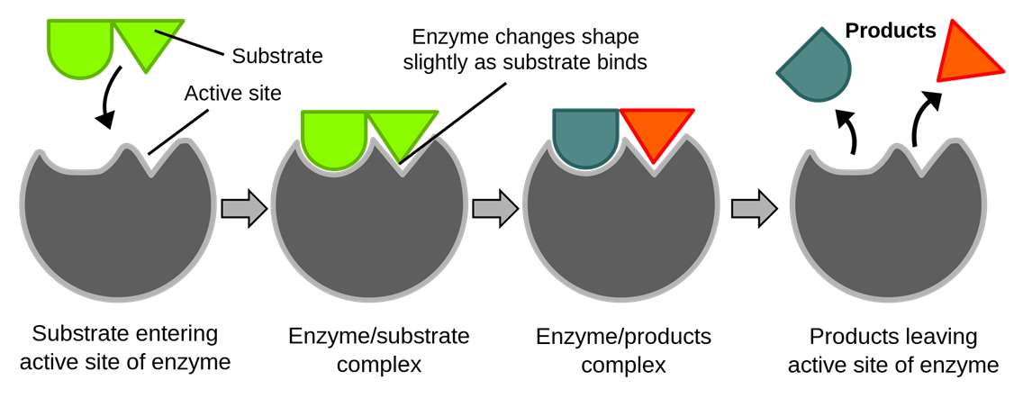
Interaction of drugs with targets

Slide 6
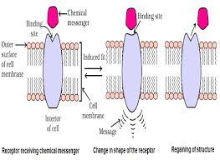
Receptors as Drug targets

Slide 7
Chemicals in Medicines and Health Care
The chemical substances used for treatment of diseases and for reducing suffering from pain are called medicines or drugs.
The term chemotherapy is used for the science in which suitable chemicals are used for the treatment of a disease.

Slide 8
Some of medicinal compounds:
Antipyretics: The chemical substances used to lower the temperature. E.g. aspirin, paracetamol.
Analgesics: The chemical substances used to relieve pains without causing impairment of consciousness, mental confusion etc. E.g. aspirin, ibuprofen, diclofenac sodium.

Slide 9
Tranquilizers: The chemical substances used for the treatment of stress, fatigue, mild and severe mental disease. E.g. noradrenaline, iproniazid.
Antiseptics: The chemical substances used to either kill or prevent the growth of micro-organism. E.g. dettol, bithional, iodine.
Disinfectant: The chemical substances used to kill micro-organism but cannot be applied on living tissues. E.g. thymol, chlorine (0.2-0.4 ppm)

Slide 10
Antimalarials: The chemical substances used for the treatment of malaria. E.g. chloroquine, paraquine.
Antimicrobials: The chemical substances used to cure infections due to micro-organisms. E.g. prontosil, sulphadiazine.
Antifertility drugs: The chemical substances used to control pregnancy. E.g. mifepristone, ormeloxifene.

Slide 11
Antibiotics: The chemical substances produced by micro-organisms and can inhibit the growth or even destroy other micro organism. E.g. penicillin, ampicillin.
Antacids: The chemical substances which neutralize excess acid in gastric juices and give relief from acidity, heart burns and gastric ulcers. E.g. ranitidine, omeprazole.
Antihistamines: The chemical substances which diminish or abolish the main actions of histamine released in the body and hence prevent the allergic reactions. E.g. terfenadine, promethazine.

Slide 12
Thank You

